Slide 1
POLARIZATION

Slide 2
Types of Polarization
Unpolarized Light
Plane Polarized Light
Circularly Polarized Light
Elliptically Polarized Light

Slide 3
Unpolarized Light
The light having vibrations along all possible direction perpendisular to direction of propagation of light is called is called as unpolarized light.
Plane Polarized Light
The light having vibration only along a single plane perpendicular to direction of propagation of light is called as Polarized light.
Circularly Polarized Light
It is a type of polarization where electric field vectors rotates in a circular motion as the wave propagates. In circularly polarized light , the electric field components oscillate in two perpendicular direction with equal amplitude and phase diff is 90 degree.
Elliptically Polarized Light
It is a type of polarization where electric field vectors describes an ellipse in a given plane perpendicular to the direction of propagation. the electric field components oscillate in two perpendicular direction with different amplitude and phase diff is 90 degree. It includes linear and circular polarization.

Slide 4
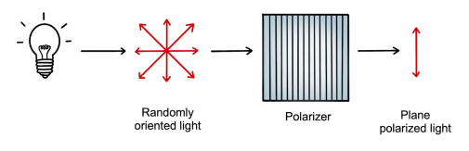
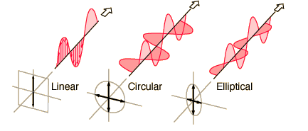

Slide 5


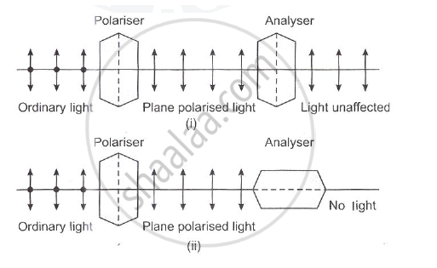
Malus Law
The Malus law states that the intensity of a plane-polarised light that passes through an analyser is directly proportional to the square of the cosine of the angle between the plane of the polariser and the transmission axis of the analyser. I=I_{O}COS²Ɵ

Slide 6
Production of plane polarized light
1. by reflection
2.by refraction
3.by double refraction

Slide 7
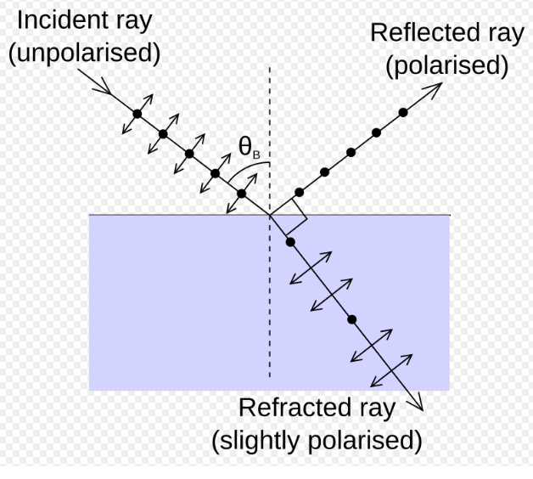
Polarization by reflection

Slide 8
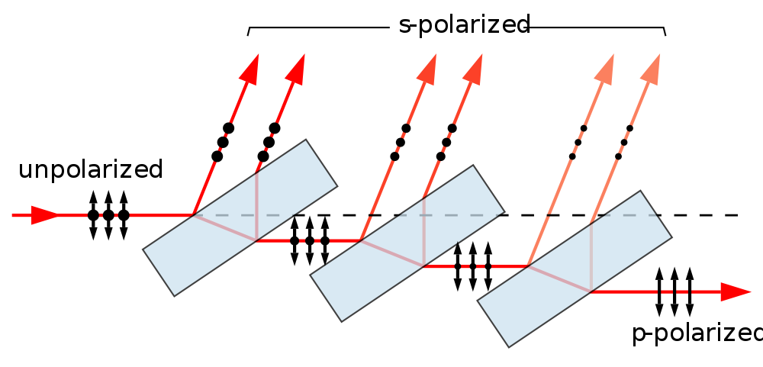
Polarization by refraction

Slide 9
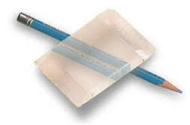
DOUBLE REFRACTING CRYSTAL
There are certain crystal which shows the property of splitting of a light ray incident on them (i.e.splitting into two refracted ray)
Uniaxial crystal
Biaxial crystal

Slide 10
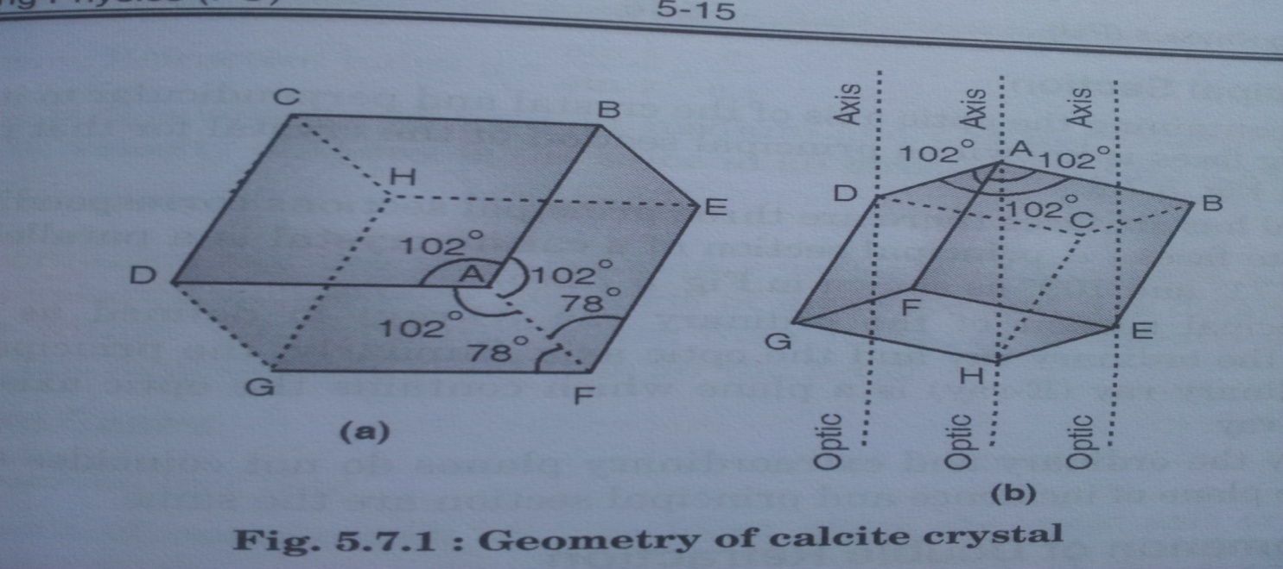
Calcite crystal:-
Colourless transparent crystal
Calcium carbonate(CaCO₃)
At corners , the three angles of faces meeting there are all obtuse (larger than 90°) These corners are known as blunt corners.

Slide 11
Propogation of light in calcite crystal
Calcite crystal: Negative Crystal
Cases:( Note: optic axis is to be considered
in the plane of incidence)
Optic axis perpendicular to crystal surface.
Optic axis parallel to the crystal surface
Optic axis inclined to the crystal

Slide 12
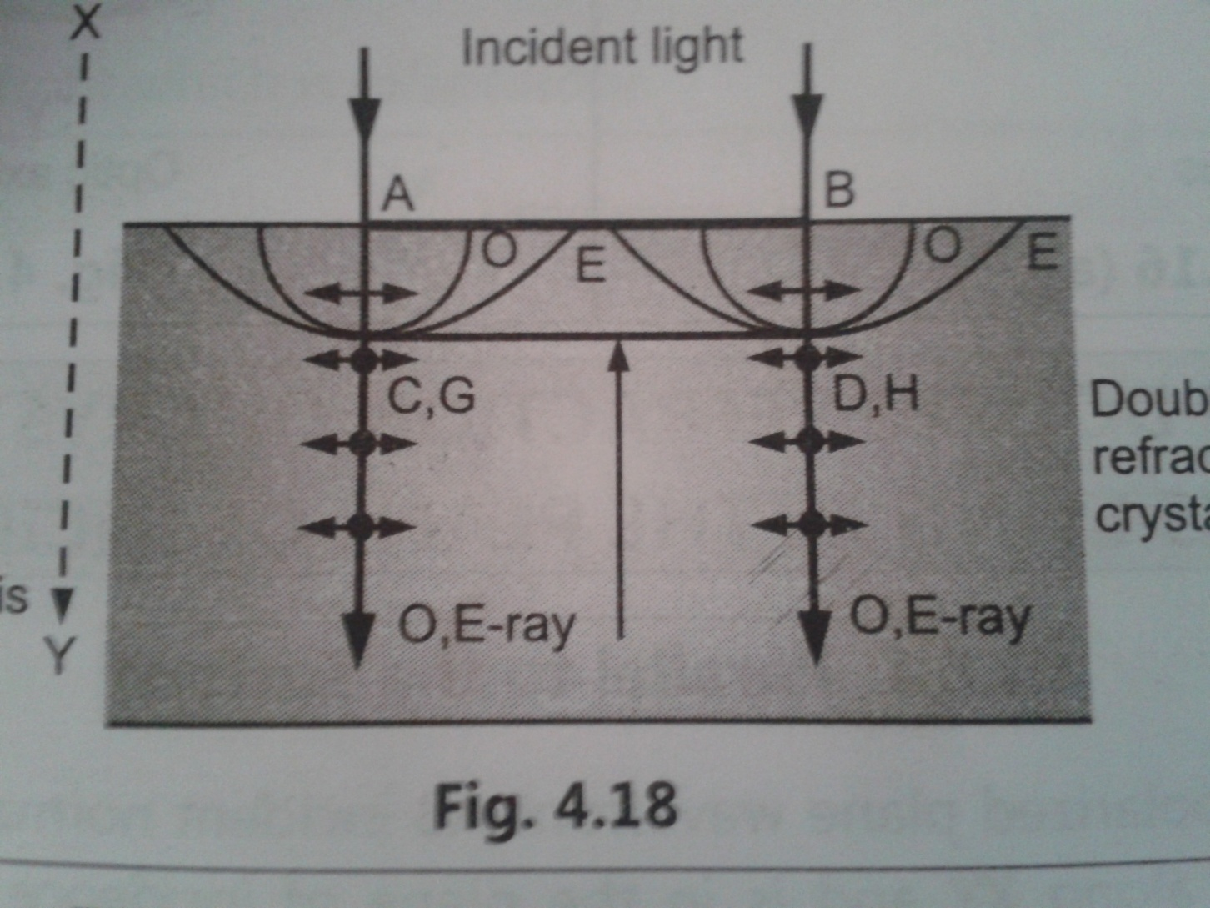
Optic axis perpendicular to crystal surface.
O ray and E ray travel with same velocity in the same direction

Slide 13
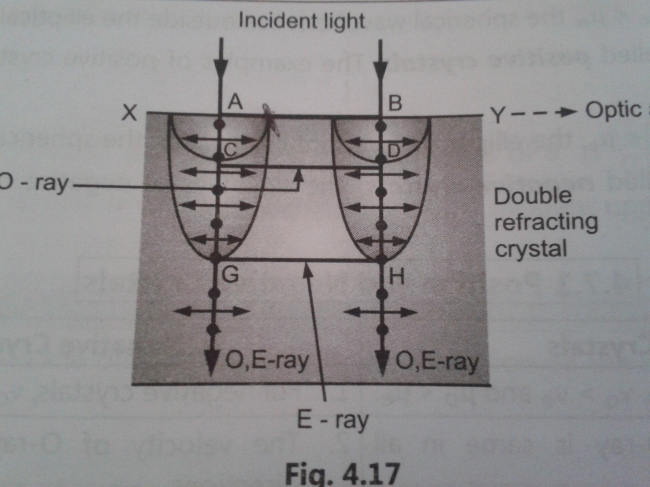
Optic axis parallel to the crystal surface
O ray and E ray travel with different velocity in the same direction

Slide 14
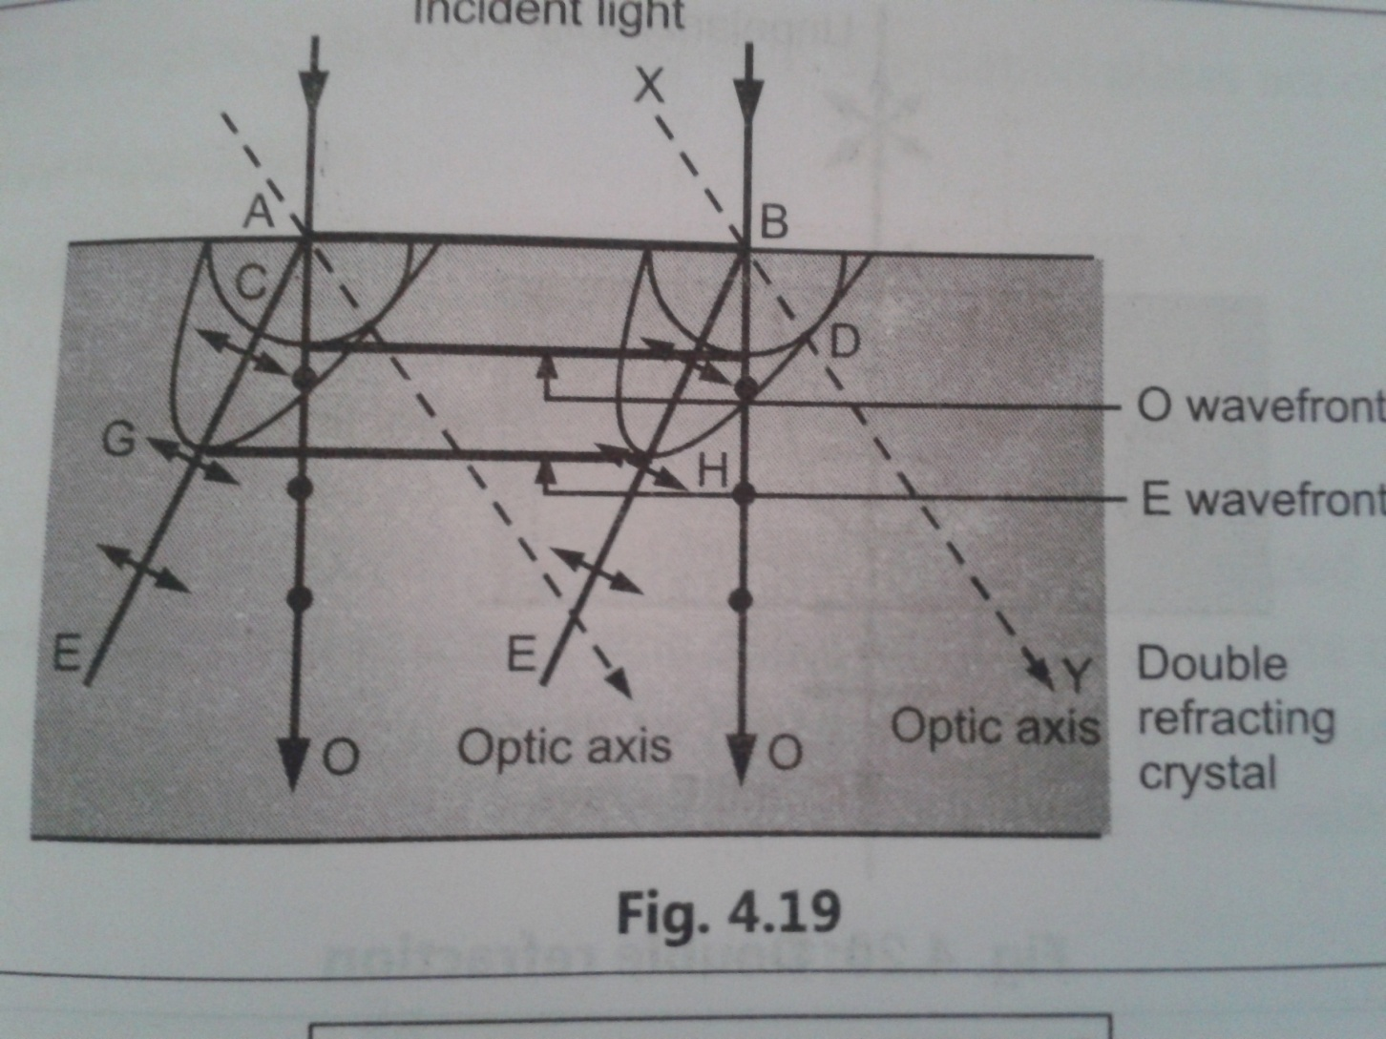
Optic axis inclined to the crystal surface

Slide 15
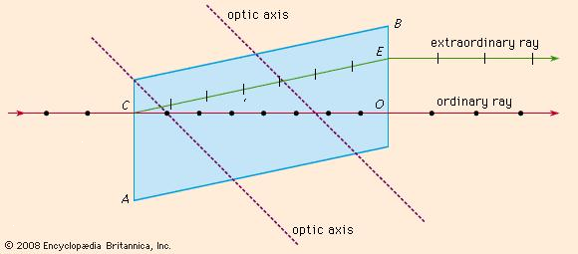
Huygen’s theory of double refraction:-

Slide 16
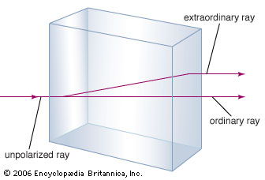
Double refraction:-

Slide 17
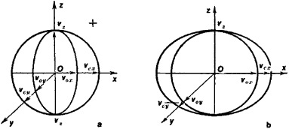
Positive crystal:-
Negative crystal:-

